Slide 1
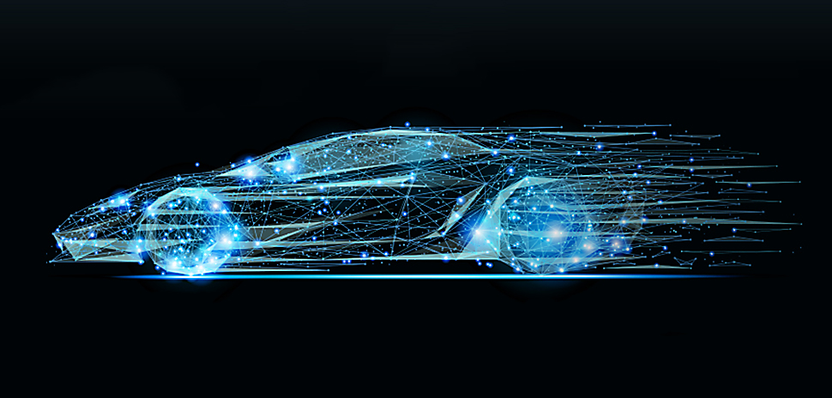

Al-Azhar university
Faculty of Engineering
Electronics & communication Department
ADAS COLLISION AVOIDANCE

Slide 2
Content
Introduction
01
Embedded Linux
05
Subsystems
06
ADAS
02
Project Architecture
03
V2V Communication
04

Slide 3
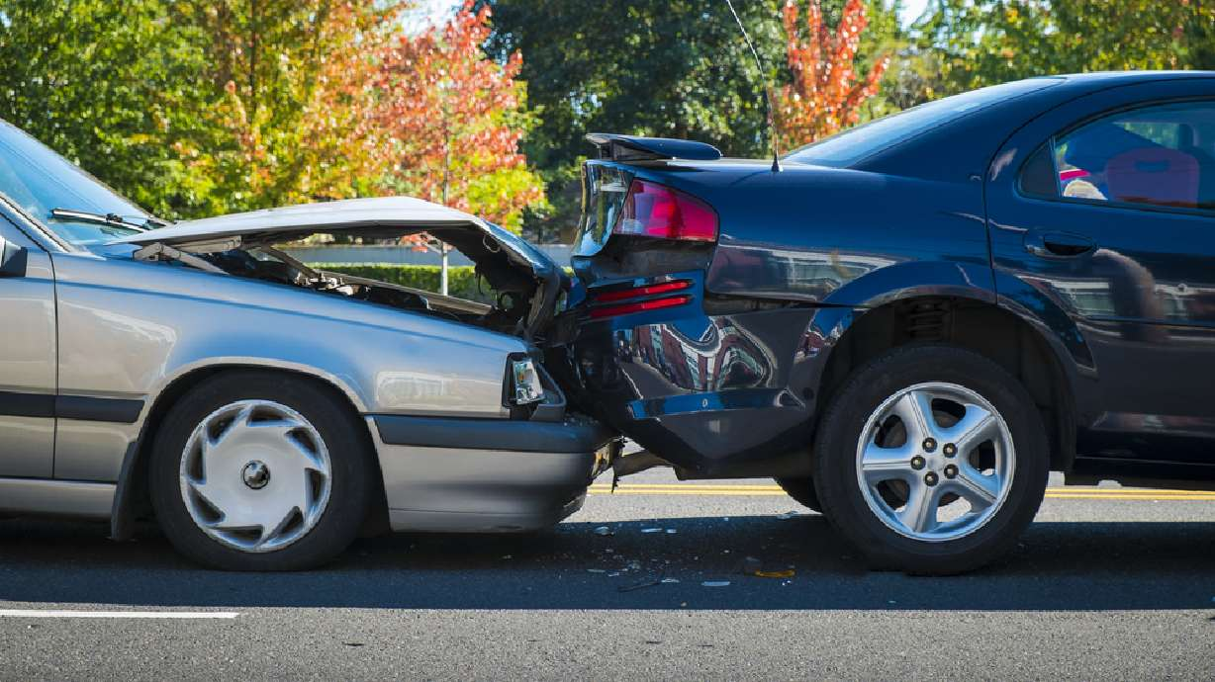
Introduction
Road safety becomes a major public health.
Annually, approximately 1.19 million people die as a result of road traffic crashes, making it one of the leading causes of death worldwide (World Health Organization (WHO))
road crashes lead to the global economic losses.
20 to 50 million people sustaining non-fatal injuries each year, many of which lead to long-term disabilities.

Slide 4
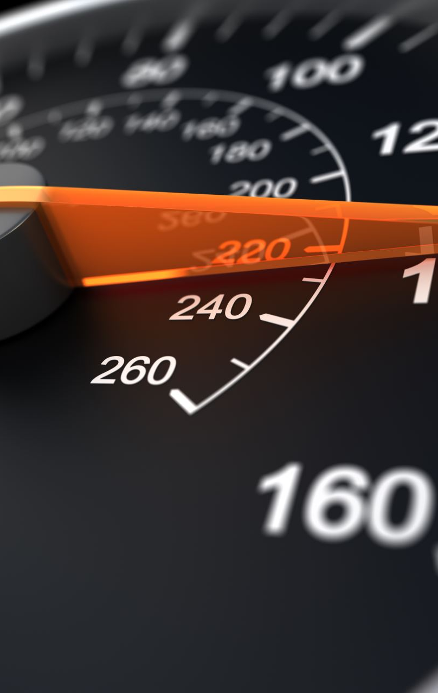
Main cause of accidents
Main cause of accidents and crashes are due to human errors, We are elaborating some of the common behavior of humans which results in accidents:
Over Speeding
Distraction to Driver

Slide 5
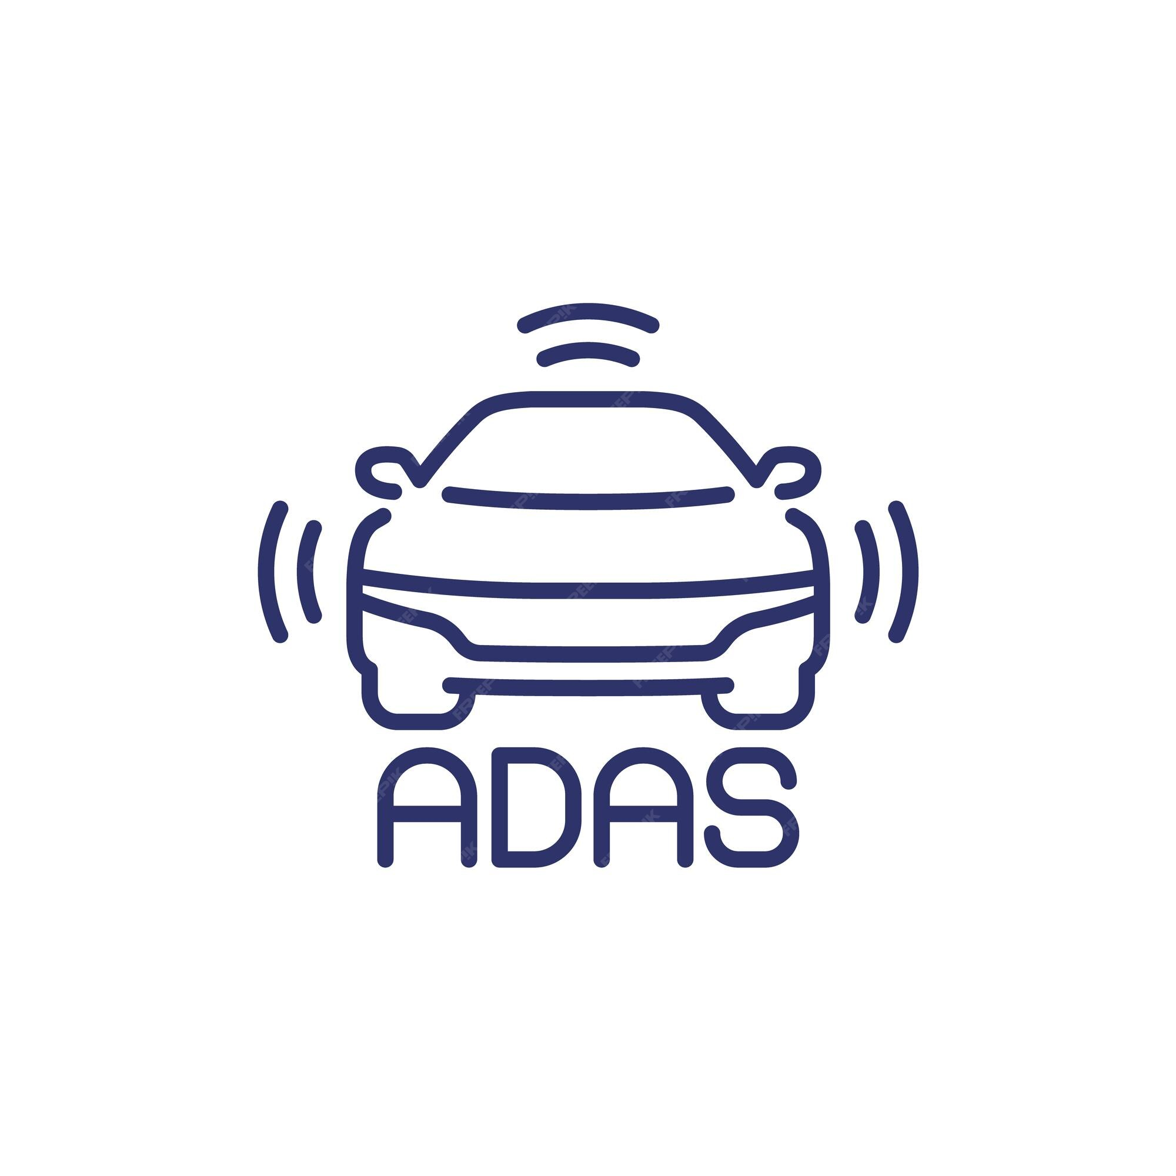

How our project solves this problem?
Project includes some of advanced driver assistance system (ADAS) applications.
V2V technology used to communicate between vehicles.

Slide 6
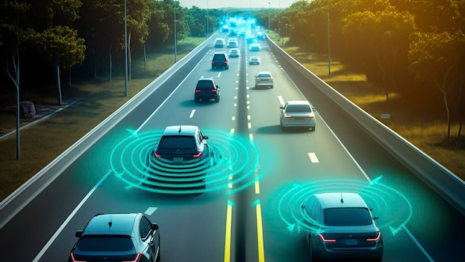
WHY ADAS?
Reduced human error: by incorporating automation, ADAS aims to reduce human errors, a leading factor in road accidents, contribution to overall road safety..
Safety enhancement: ADAS enhances vehicle safety through features like collision avoidance.
Driver assistance: it provides real time assistance to drivers, improving overall driving experience by aiding in tasks like parking.
Sensor integration: ADAS relies on various sensors such as Cameras, radar and Lidar to gather and process information for decision making.

Slide 7
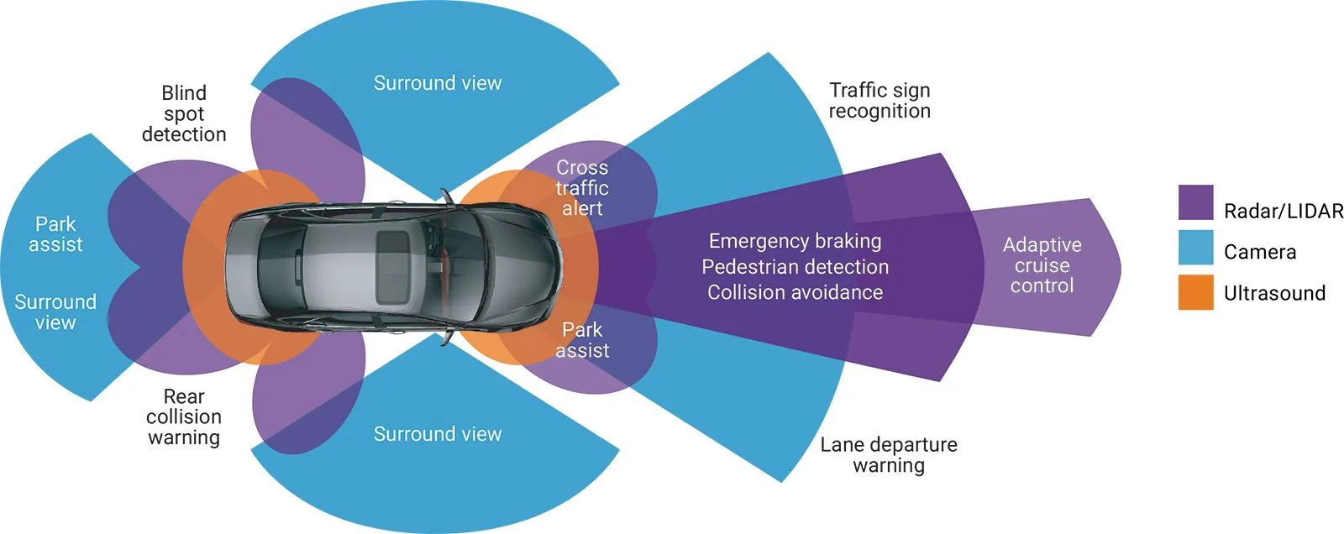
How ADAS work?
ADAS is a complex system that relies on various components working together seamlessly.

Slide 8
GOALS AND OBJECTIVES
The objective of this project is to design a system based on V2V communication technology.
Saving time by helping people to park easily and make the driving journey easily and more comfortable.
The project aims to enhance automotive safety and convenience by integrating advanced driver assistance systems into a cohesive and intelligent framework.

Slide 9


Project Architecture
Module A: Hardware and Sensors.
Module B: Software Architecture.
Module C: Embedded Linux Application with Internet of Things.
Module D: Subsystems.

Slide 10
Hardware and Sensors
STM32F103C8T6
The Raspberry Pi
The Sensors and Actuators

Slide 11
Software Architecture
Universal Asynchronous Receiver Transmitter (UART)
Bluetooth

Slide 12
Embedded Linux Application with Internet of Things
Embedded Linux.
V2V
Communication

Slide 13
Subsystems
ADAPTIVE CRUISE CONTROL (ACC)
01
AUTO EMERGENCY BRAKING (AEB)
02
SELF PARKING
03

Slide 14
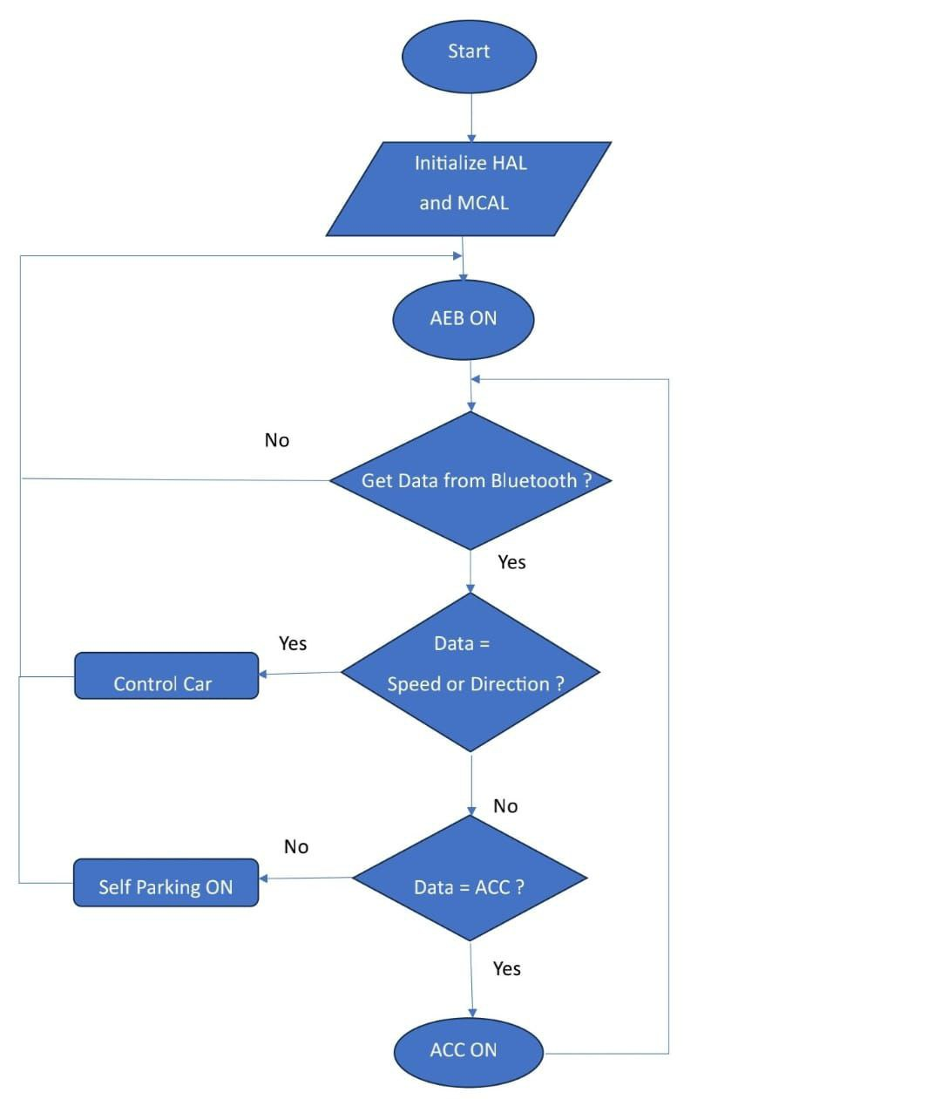
Project flow chart

Slide 15
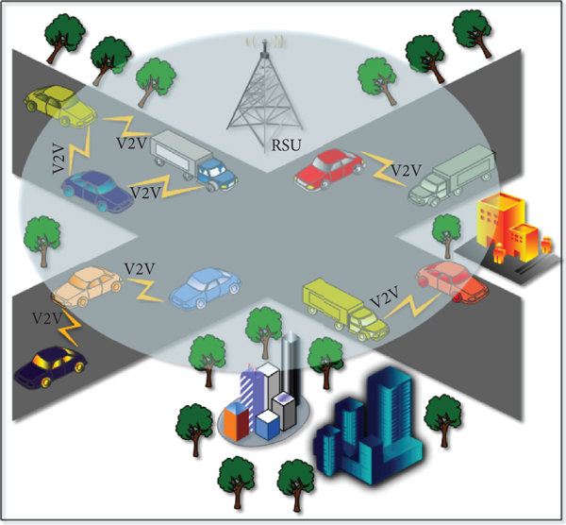
V2V Communication
Vehicle-to-vehicle (V2V) communication’s ability to wirelessly exchange information about the speed and position of surrounding vehicles shows great promise in helping to avoid crashes, ease traffic congestion, and improve the environment.

Slide 16
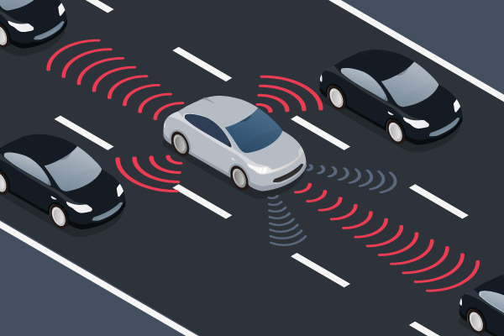
Why V2V is important?
V2V communication technology can increase the performance of vehicle safety systems and help save lives.
When one car brakes suddenly, for example, cars several yards behind the vehicle could get a safety warning before they get too close.

Slide 17
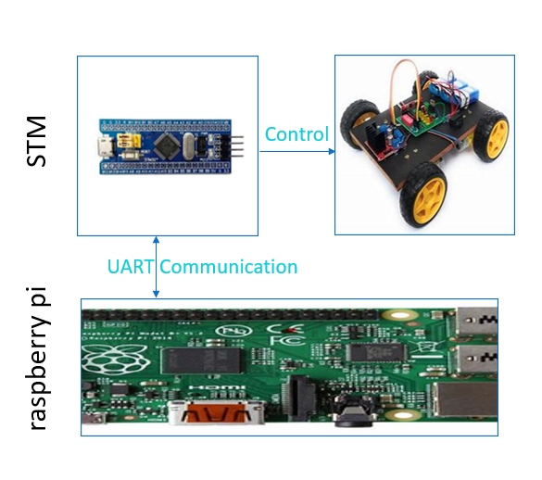
V2V BLOCK DIAGRAM
Wi-Fi
Vehicle 1
Vehicle 2

Slide 18



EMBEDDED LINUX
why Linux ?
Linux with raspberry pi role in V2V

Slide 19

why Linux ?
Linux is open-source software and is free to use for public.
Linux is highly secure, flexible, and can receive excellent support from a large community of users.
In terms of sensitivity : Linux file system is case-sensitive.
Linux is more efficient in operations as compared to windows.
Linux is Multitasking and Multiuser.
Faster developer.

Slide 20
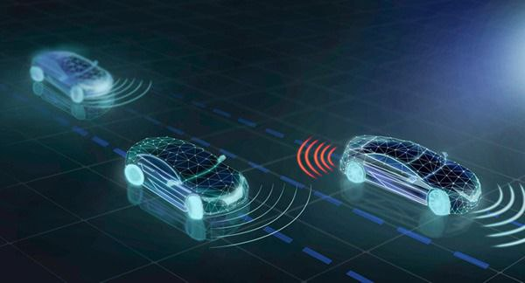
Linux with raspberry pi role in V2V
1. The Blue Pill Interface with Raspberry Pi to Start the Measurements using UART.
2. Connect between Two Raspberry Pi by using MQTT.
3. send speed and direction from the first car to the second and create a graphical user interface (GUI) on a Raspberry Pi 3 B using both Qt or Tkinter.

Slide 21
1- The Blue Pill Interface with Raspberry Pi to Start the Measurements using UART.

Slide 22
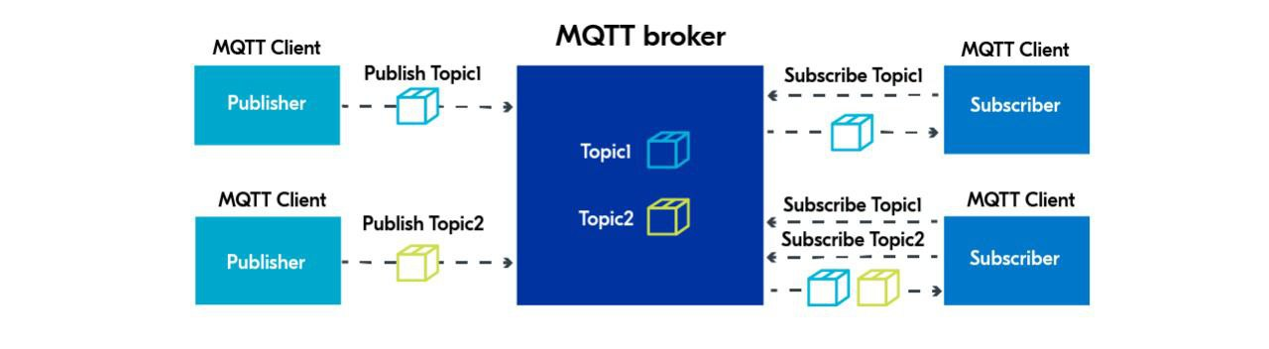
What is MQTT and how it work ?

Slide 23
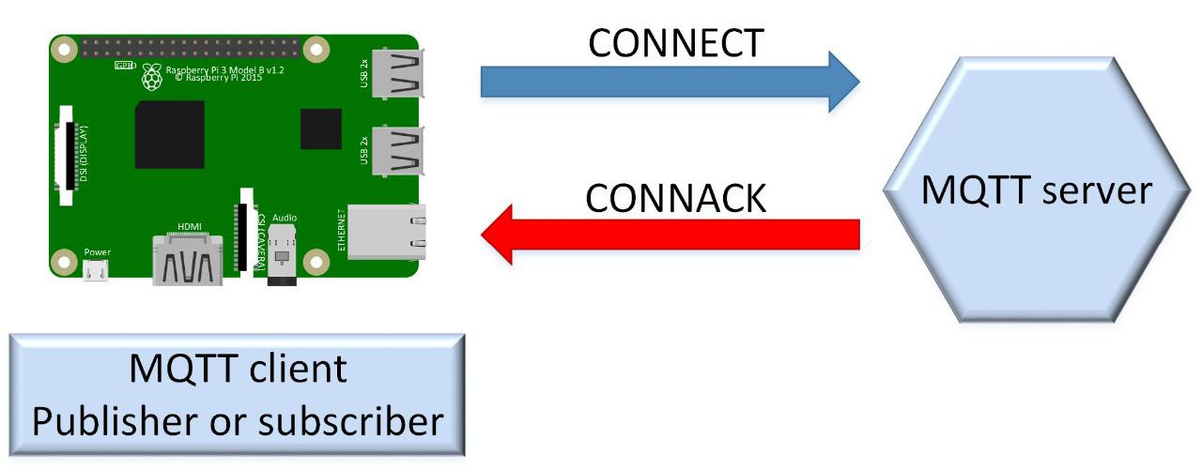
2-Connect between Two Raspberry Pi by using MQTT.
MQTT (MQ Telemetry Transport) is a Client-Server publish/subscribe messaging transport protocol.
The typical MQTT architecture can be divided into:
Client
Broker
Message
Topic

Slide 24
Flow chart

Slide 25
3- send speed and direction from the first car to the second and create a graphical user interface (GUI) on a Raspberry Pi 3 B using both Qt or Tkinter.

Slide 26

Our project

Slide 27
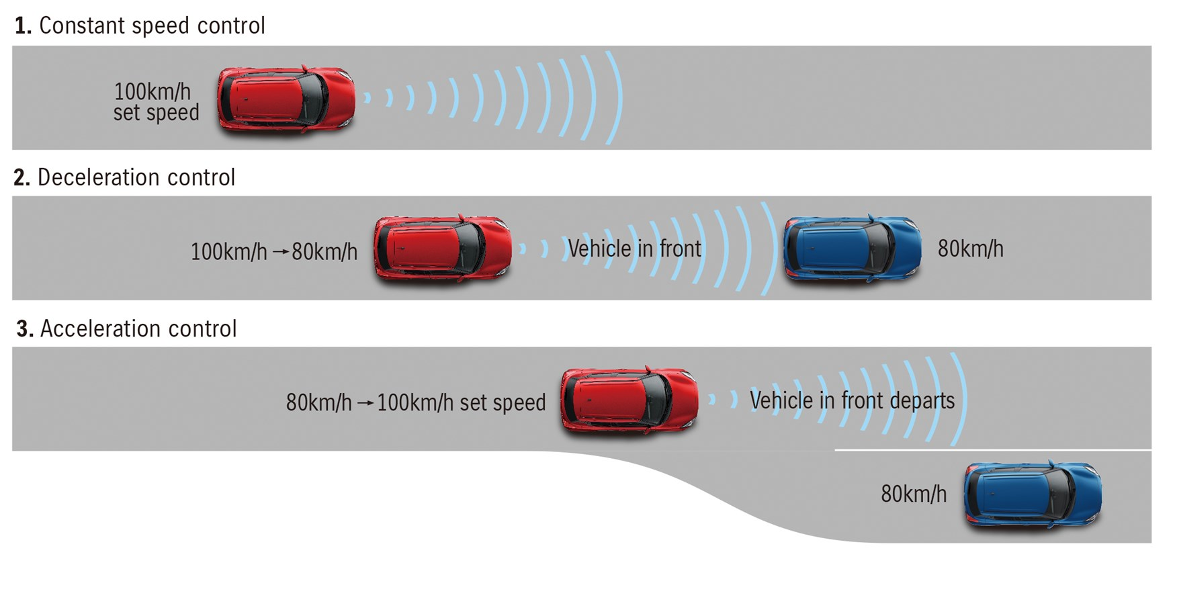
ADAPTIVE CRUISE CONTROL (ACC)
Adaptive Cruise Control (ACC) is an advanced automotive technology designed to enhance driving safety and convenience.
The system precisely and efficiently controls the vehicle's speed, reducing driver fatigue and increasing comfort during long trips.
ACC contributes to improved fuel efficiency by maintaining a steady speed and minimizing sudden acceleration and deceleration.

Slide 28
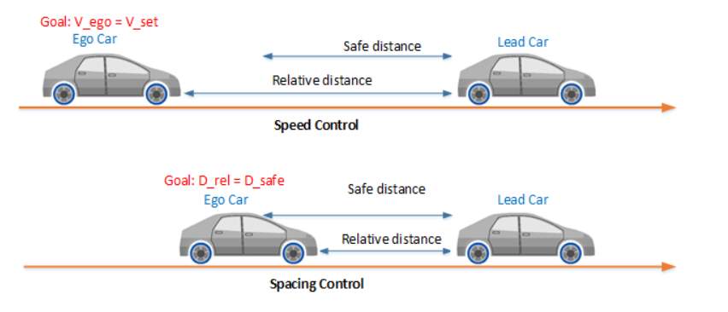
How ACC work?
The system utilizes a combination of sensors and communications between cars .
ACC automatically adjusts the vehicle's speed to maintain a safe following distance from the car in front. When the vehicle approaches a slower-moving car, the system gradually reduces the speed to avoid collision.
Once the road ahead clears, the system accelerates the vehicle back to the preset speed chosen by the driver .

Slide 29
Main algorithm
Read “V_set”
Read”D_safe”
Measure”D_rel”
D_rel>=D_safe?
YES
NO
V_actual = V_set
V_actual = V_ahead

Slide 30
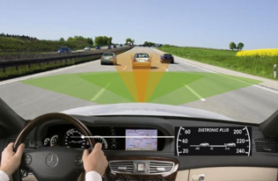
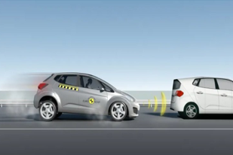
AUTO EMERGENCY BRAKING SYSTEM
Problem Definition :
Nowadays, the number of accidents is so high and occurs everywhere causing the worst damage, serious injuries and death. These accidents can be caused due to the delay of the driver to hit the brakes.

Slide 31
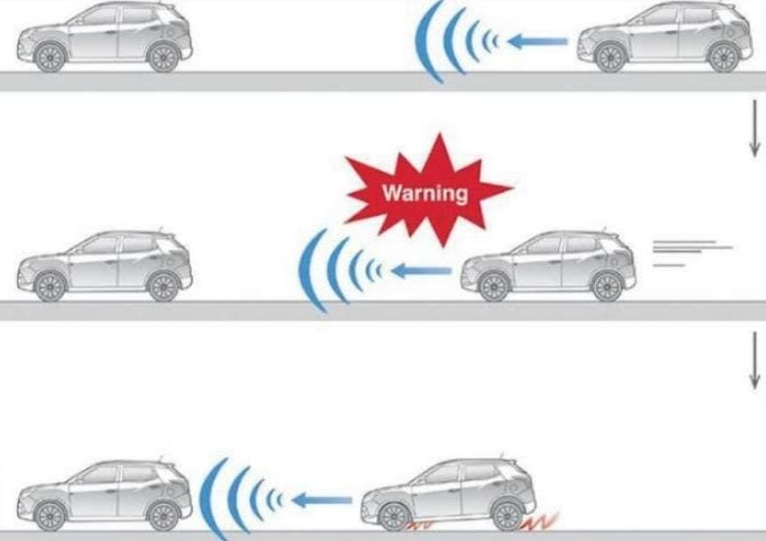
System Description
AEB is a safety system that can identify when a possible collision is about to occur and responds by autonomously activating the brakes to bring the vehicle to stop to avoid collision.

Slide 32
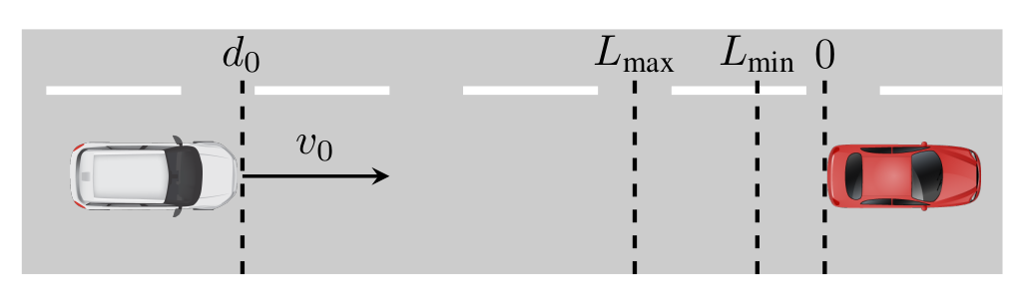
States of AEB:
Normal State
➢ Distance From Ultrasonic > MAXIMUM DISTANCE
Warning State
➢ MINIMUM DISTANCE <= Distance From Ultrasonic <= MAXIMUM DISTANCE
Auto Braking State
➢Distance From Ultrasonic < MINIMUM DISTANCE

Slide 33
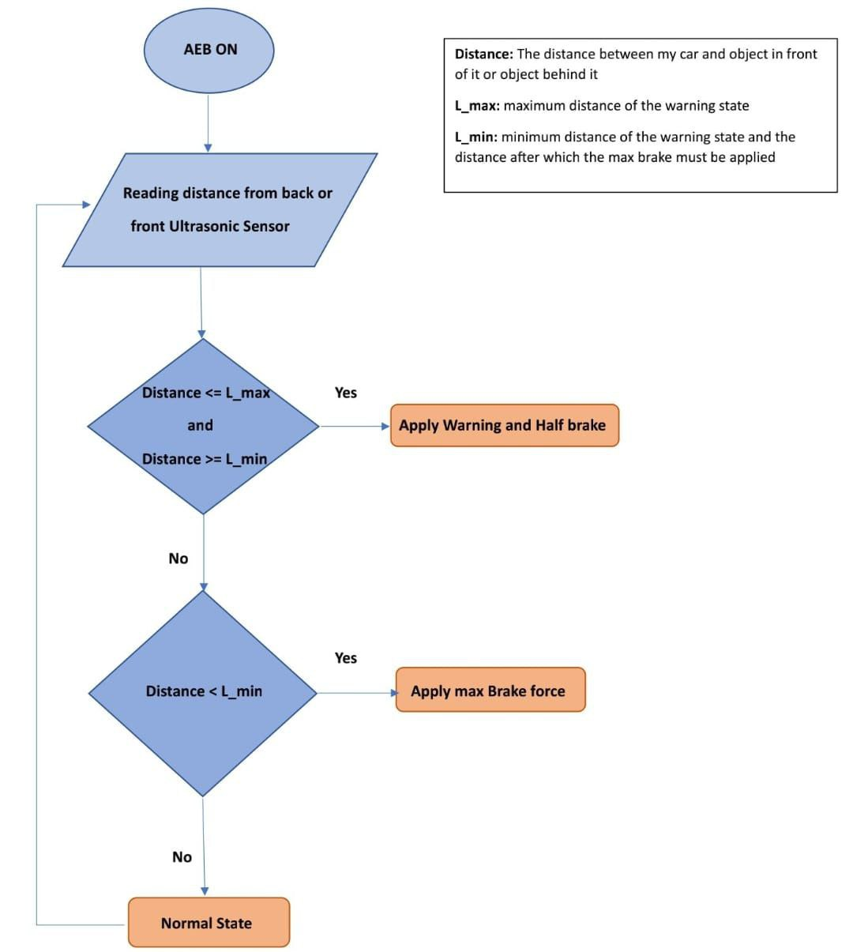
Main algorithm

Slide 34
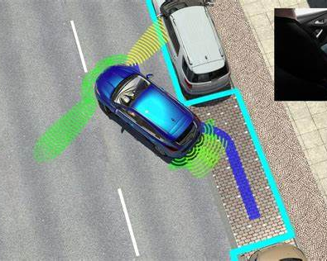
SELF PARKING SYSTEM
Problem Statement:
Most of the time people suffer from the problem of parking the car in the appropriate places due to high traffic demand, Following the rapid increase of car ownership, many cities are lacking car parking areas.

Slide 35
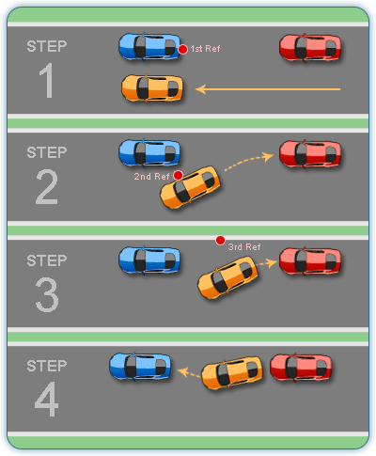
System Description
This system simplifies the parking process, ensuring precise and safe maneuvering into parking spaces with minimal driver intervention.
Ultrasonic sensors, scan continuously for available parking spaces and detect obstacles.

Slide 36
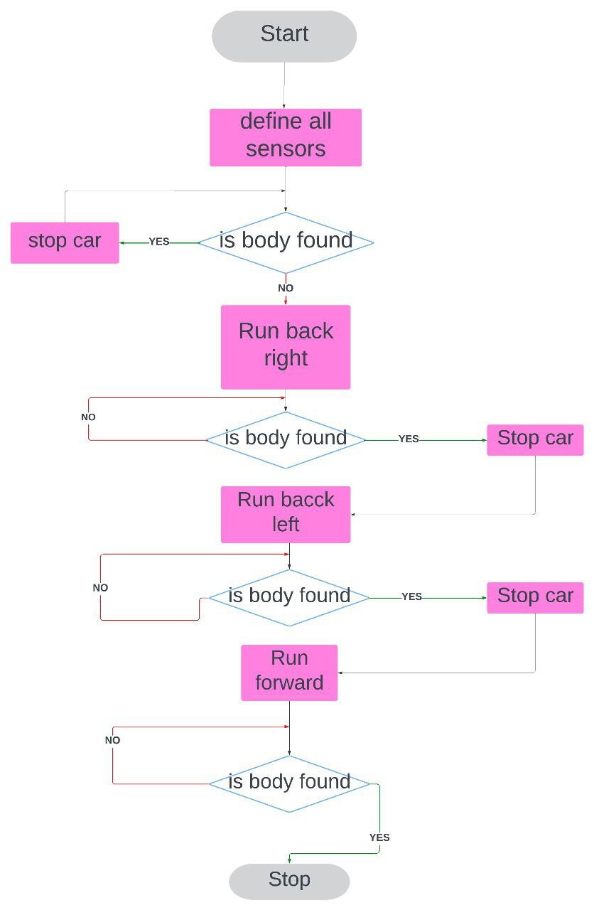
Main algorithm

Slide 37

Future Work
Advanced Sensor Technologies
V2X communication.
User Interface Improvements.
Implement Al and machine learning algorithms.

Slide 38
Our Team
Toqa Mohamed
Eman Khaled
Esraa Taha
Esraa Ali
Amina Mohamed
Doha Magdy
MennatAllah Mohamed
Sohaila Ibrahim

